Slide 1
Anomaly Detection

Slide 2
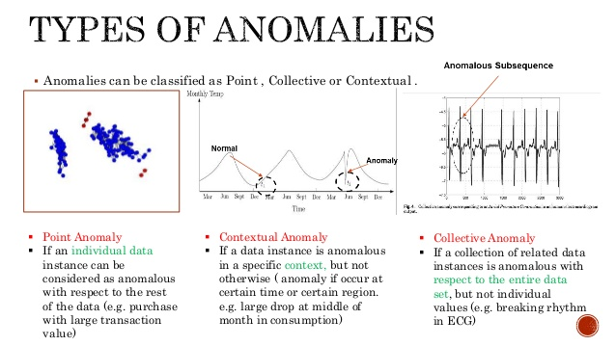
What is Anomaly Detection
Given a small dataset of “positive” outcomes, build a classifier model that is able to determine when outliers (“negative”) outcomes are presented
Supervised, Unsupervised, Semi-Supervised
Intrusion Detection, Fraud Detection, Eco-system Disturbances, System Health Monitoring

Slide 3
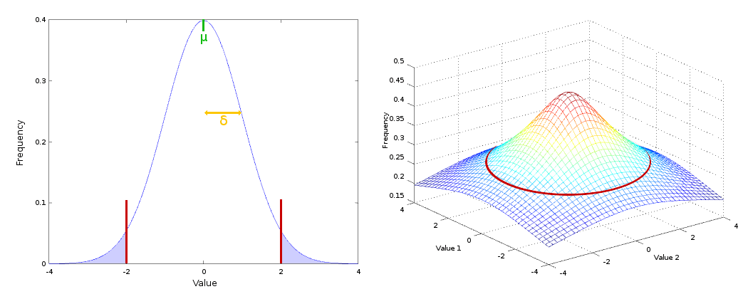
Normal Distribution Probabilistic Model
Probabilistic Model that makes use of Mean, Standard Deviation and Normal (Gaussian) Distribution to discover outliers
Below a Specific threshold value, a datapoint is deemed an anomaly
Strong Points:
Able to create new features to better classify
Easy to vary features of the model (threshold value…)
Multivariate Gaussian Distribution

Slide 4
Other potential models
DBSCAN: Makes use of Euclidean Distance between points to create a pseudo decision boundary
Support Vector Machines: Kernal based approach that identifies a region in which data resides in alternate feature space
State Space Models: Model the evolution of data and predict the potential future outcomes. Flag out if the data lies outside the prediction
Auto Encoders: Trains an encoder and decoder and returns a reconstruction error that can be used to detect anomalies

Slide 5
Relevance to our project
Not really relevant since we are looking to perform classification between satisfied and unsatisfied based on EGG data
However, can be potentially useful to flag out unnecessary datapoints or features

